Slide 1

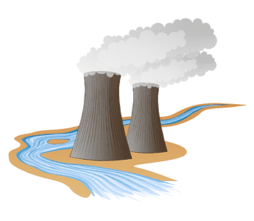
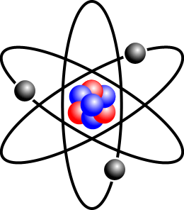

Latest achievements in nuclear research

Slide 2
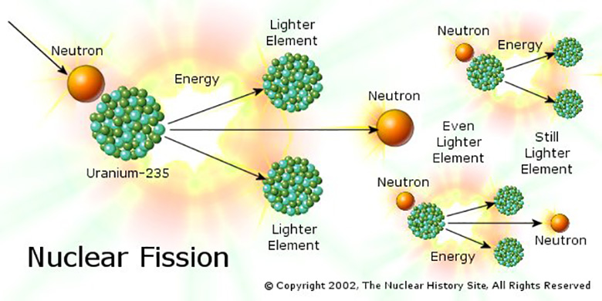
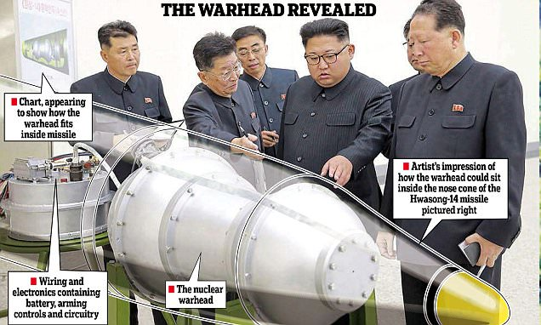
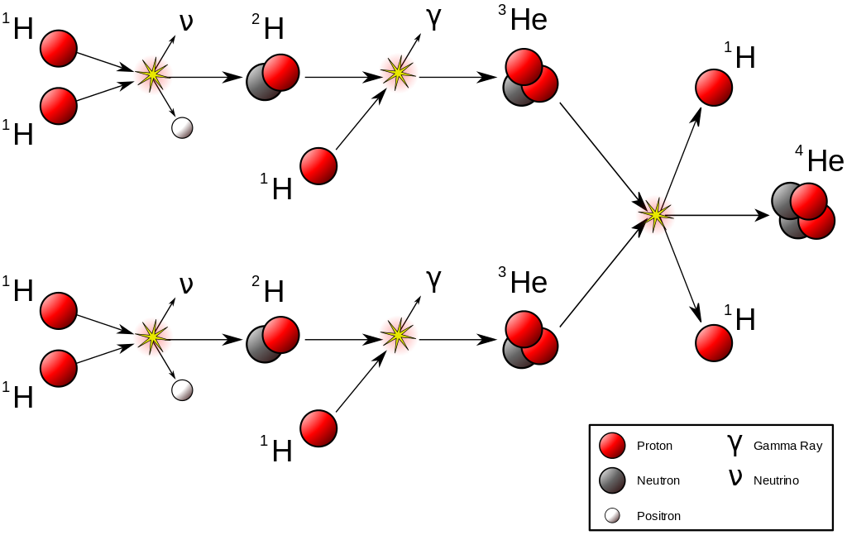
Nuclear fission
Nuclear waste problems
Nuclear fusion
Synthesis reactions of hydrogen and helium
Hydrogen bombs
National Ignition Facility

Slide 3
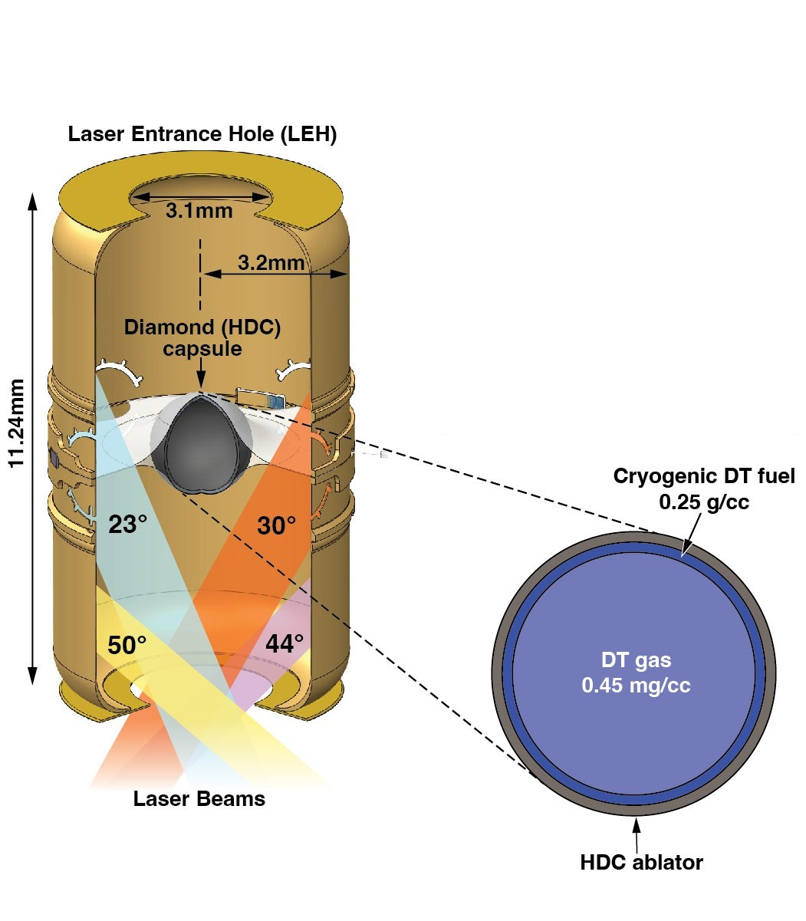
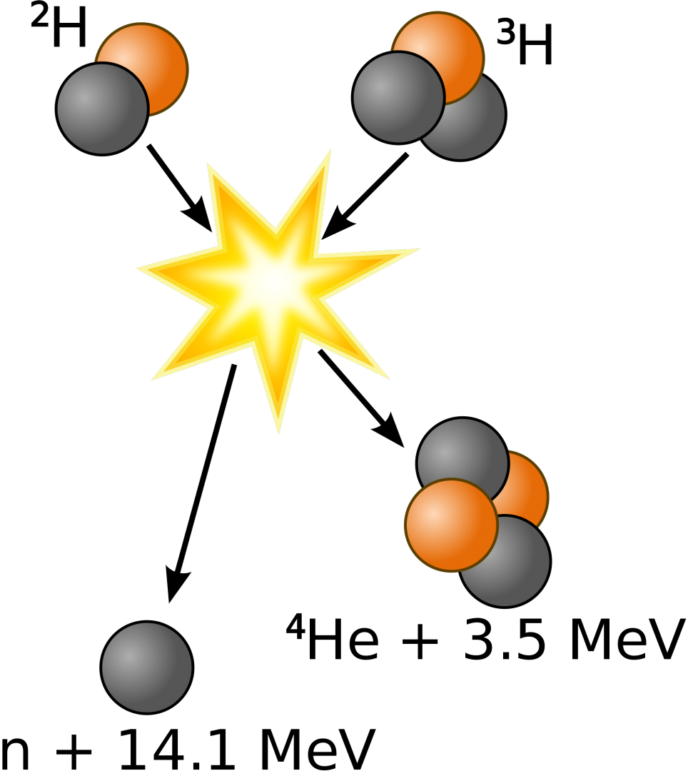
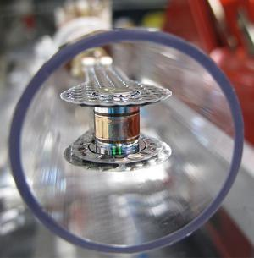
Experimental setup
Speed of the experiment
Fuel “ignition”

Slide 4
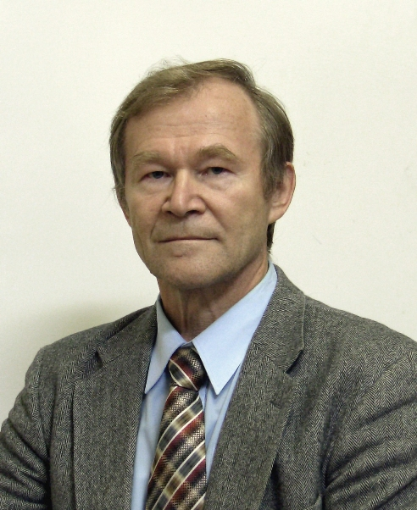


Thank you for your attention!
Soviet and Russian physicist, Doctor of Physical and Mathematical Sciences, chief researcher at the Institute of Nuclear Physics. G. I. Budkera SB RAS

